Slide 1
PROJECTION OF LINES
WEIGHTAGE=08 MARKS
Visit for more Learning Resources

Slide 2
CO’S RELATED THIS CHAPTER
Identify true length, shape and apparent length of projected object
Draw the position of line, planes, solids with reference plane

Slide 3
Straight line
A line is a geometric primitive that has length and direction, but no thickness. Straight line is the Locus of a point, which moves linearly. Straight line is also the shortest distance between any two given points.
The location of a line in projection quadrants is described by specifying the distances of its end points from the VP, HP and PP. A line may be:
Parallel to both the planes.
Parallel to one plane and perpendicular to the other.
Parallel to one plane and inclined to the other.
Inclined to both the planes

Slide 4
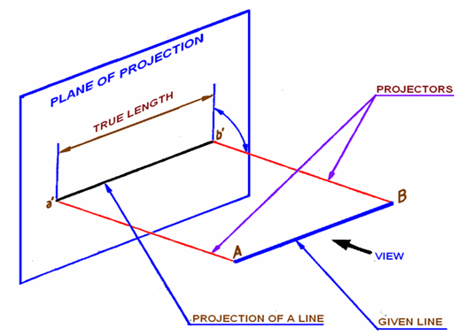
Projection of a line
The projection of a line can be obtained by projecting its end points on planes of projections and then connecting the points of projections. The projected length and inclination of a line, can be different compared to its true length and inclination.
Case 1: Line parallel to a plane
Figure 1.Projection of line on VP. Line AB is parallel to VP.

Slide 5
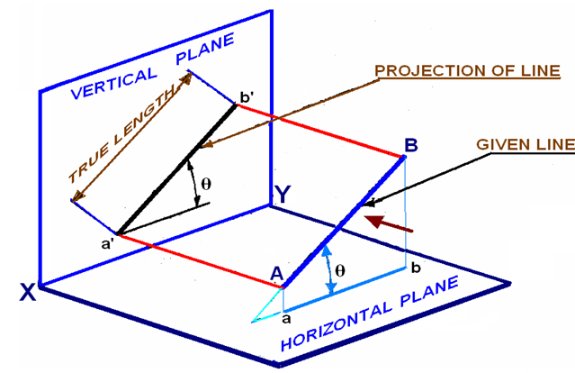
Case 2: Line inclined to a plane
Figure 2. Projection of line AB parallel to VO and inclined to HP.

Slide 6
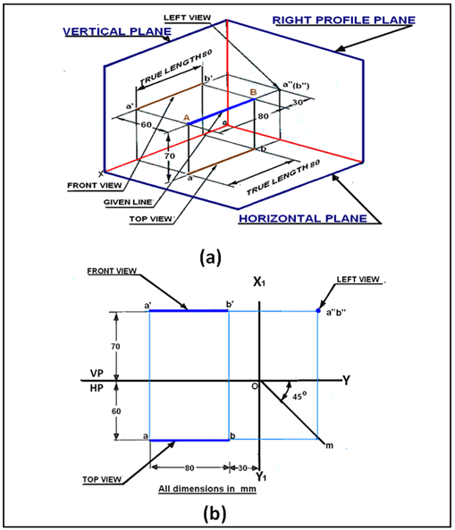
Case 3. Projection of a line parallel to both HP and VP
Figure 3. Projection of line parallel to both HP and VP

Slide 7
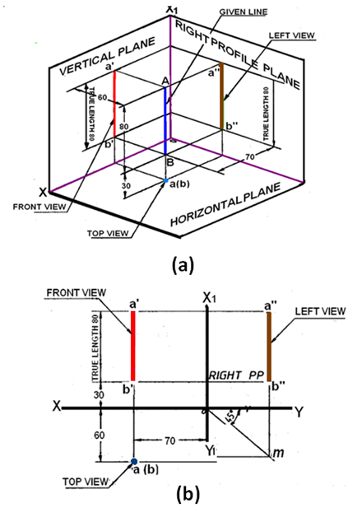
Case 4. Line perpendicular to HP & parallel to VP
Figure 4. Projections of a line AB perpendicular to HP and parallel to VP.

Slide 8
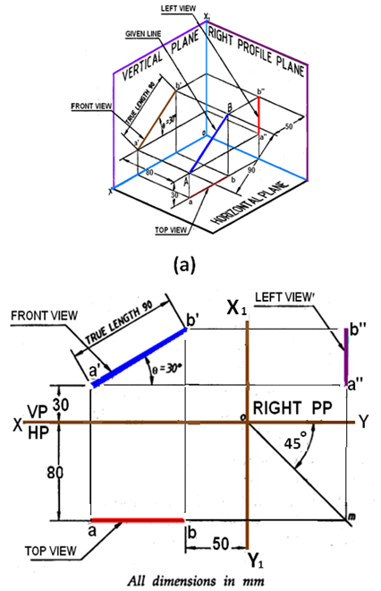
Line parallel to one plane and inclined to the other
Case 5. Line parallel to VP and inclined to HP
Figure 5. Projections of line AB parallel to VP and inclined to HP.
For more detail contact us

